Slide 1
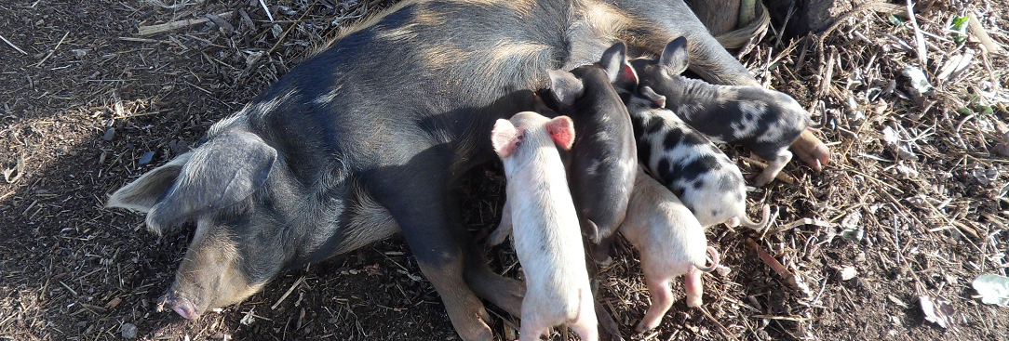

Co-created community contracts support biosecurity changes in a region where African swine fever is endemic
Erika Chenais, Karl Ståhl, Tonny Aliro, Susanna Sternberg Lewerin, Klara Fischer
GARA, Kampala, 2023
Foto: Istock
Photo: Erika Chenais

Slide 2
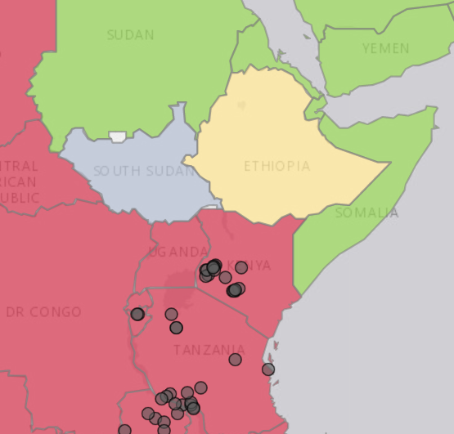
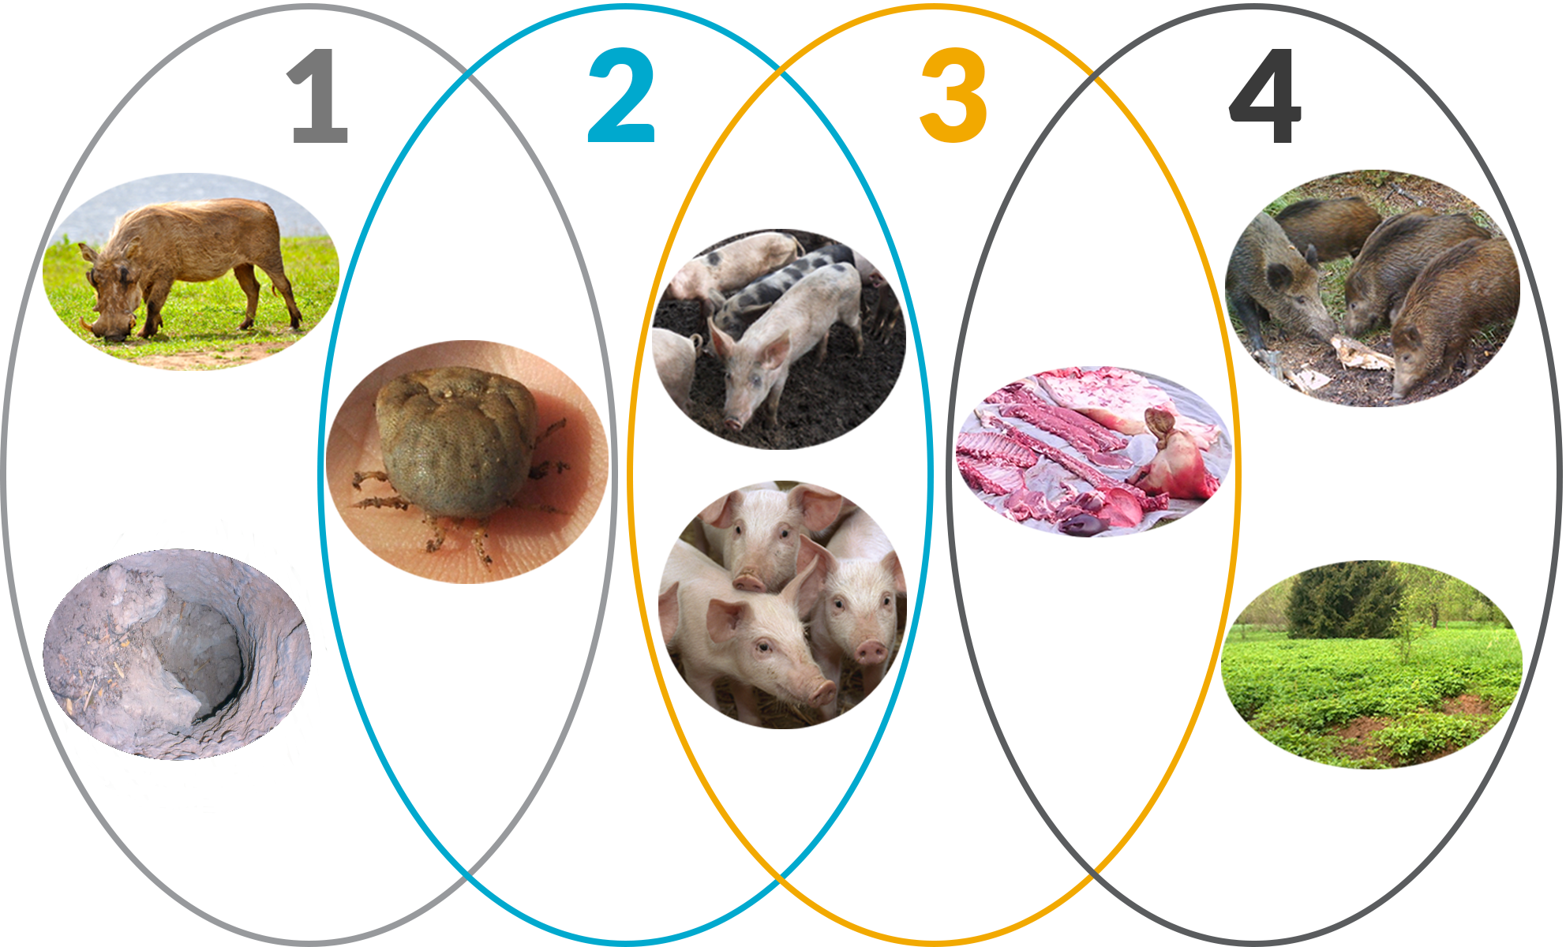
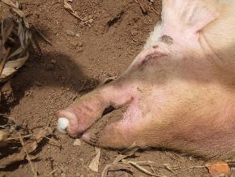
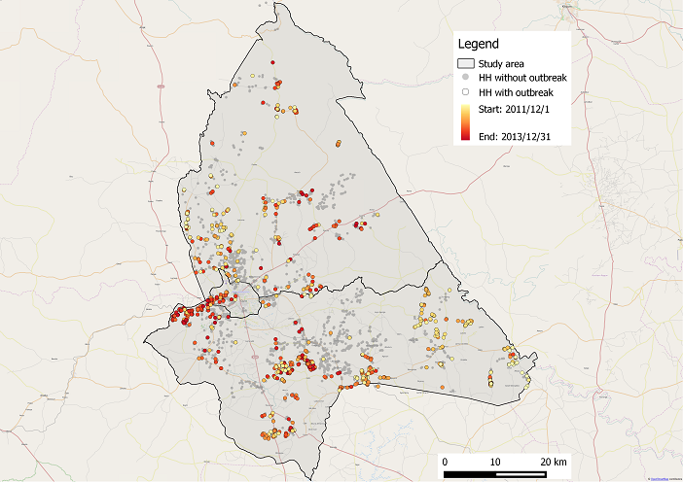
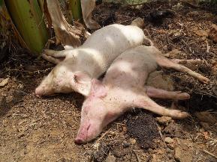
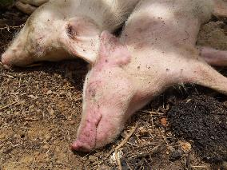
ASF in Uganda
Endemic occourence
domestic pig cycle
smallholder value chain
Map: ASF story map (windows.net) and Chenais et al 2015, Frontiers.
Photos: Erika Chenais, ML Penrith, Klaus Depner, Karl Ståhl, Bengt Ekberg.
Notes:
All my coming examples are going to be from a specific local setting in Uganda there we have studied ASF for more than ten years.
the map is from a study comparing different surveillance methods where we could confirm that the disease is endemic, with yearly incidence around 20% on houshehold level.
In our study we found a yearly household prevalance around 19%
In total 68 (35%) HH had at least one outbreak during the study period
10 HH had outbreaks twice
40 (20%) HH had outbreaks during the year before the first interview
15 (8%) HH had outbreaks between the first and the second interview
23 (12%) HH had outbreaks between the second and the third interview
39 outbreaks (last yr) 1st round (gul)
15 outbreaks 2nd round (orange)
23 outbreaks 3rd round (röd)

Slide 3
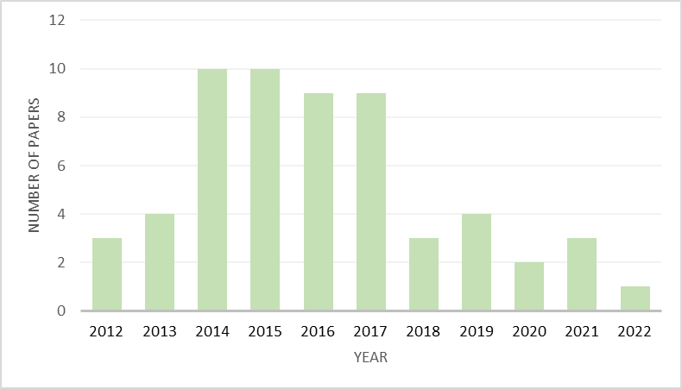
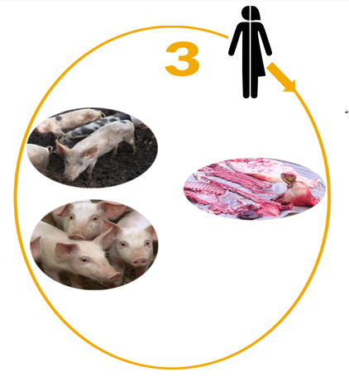

Google scholar search: Uganda and ASF, 2012-2022
Notes:
In total 58.

Slide 4
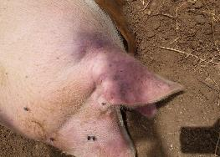
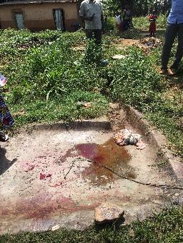
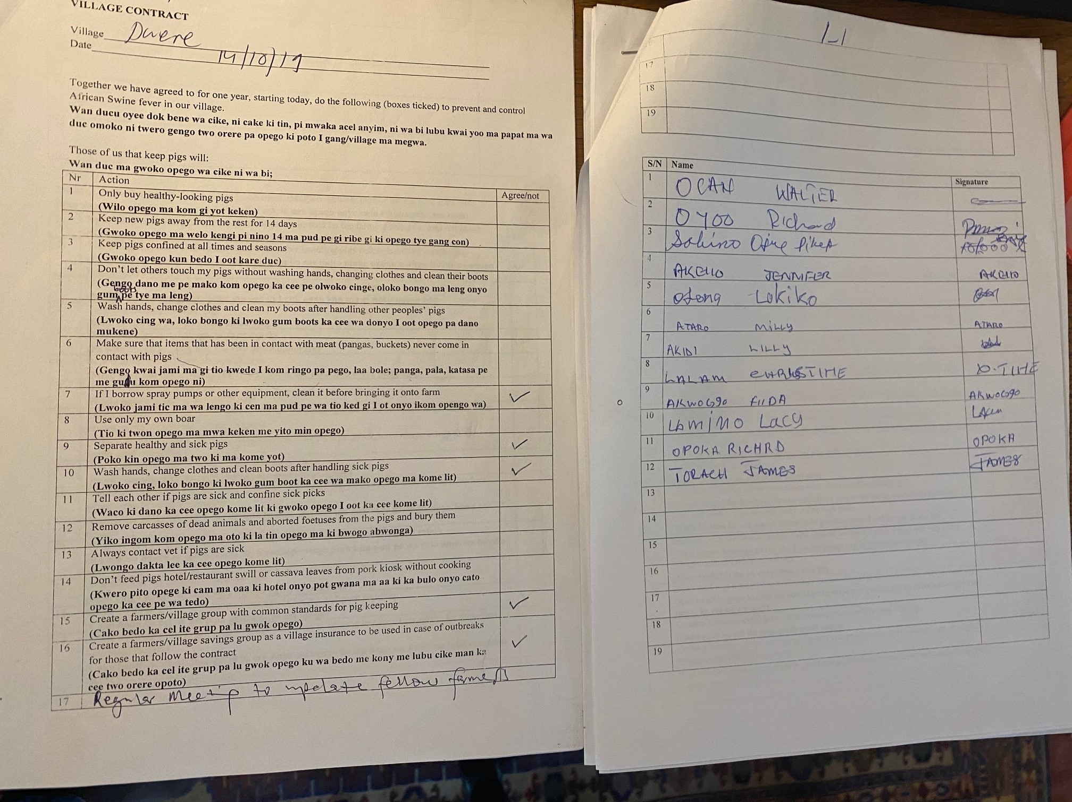
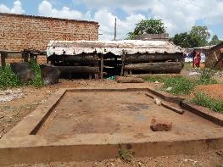
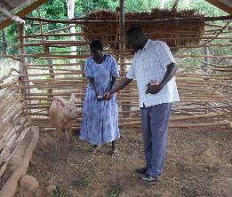
Use recent methodological developments to transform the current knowledge of ASF control and biosecurity into successfully implemented biosecurity measures on farm and community level:
Investigate the capacity for transformative change towards improved biosecurity using participatory action on community level with broad inclusion of stakeholders from the entire smallholder pig value chain
Provide stakeholders with ownership of the disease problem and the control
Test the feasibility of co-created community contracts for biosecurity
Photos: Erika Chenais
Notes:
In a context where pig production is dominated by low-input-low-output systems, mostly involving poor, marginalised groups
Communicating information regarding the ASF not being zoonotic, and how the virus is neutralized will be important for increasing acceptance and enhancing implementation for the hypothetical control interventions preventive sales, safe slaughter, and consumption of processed and safe pork
To gain in-depth understanding of the complexity of people’s behaviour, reasoning and decision-making processes, deeper involvement of the social sciences and a qualitative research approach might be used for further studies.
people part of epidemiology
all underline the importance of local acceptance and adoption of biosecurity in order to achieve effective implementation

Slide 5
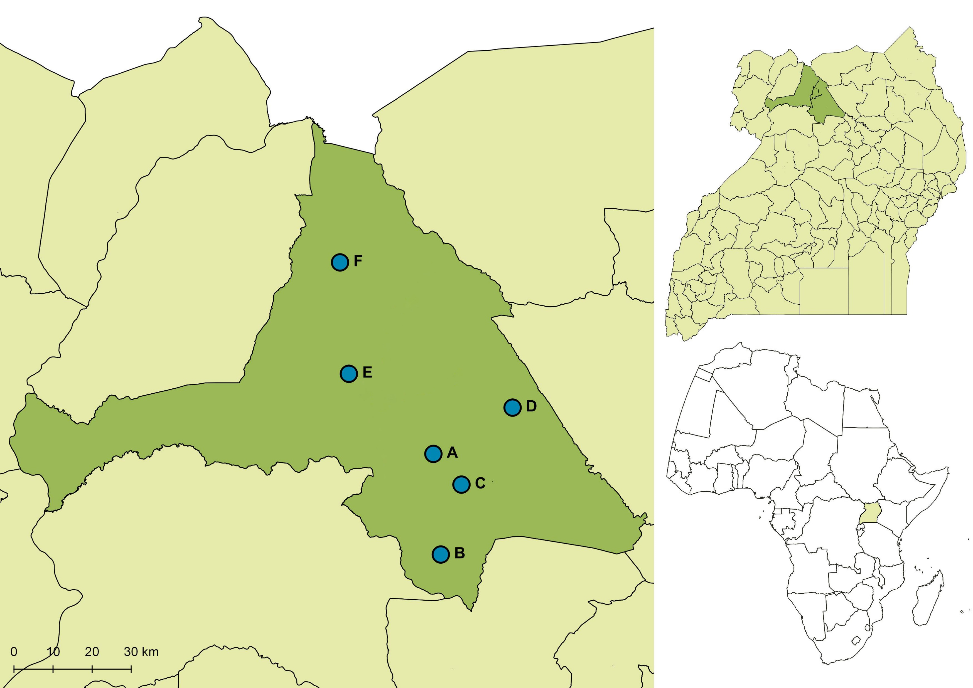
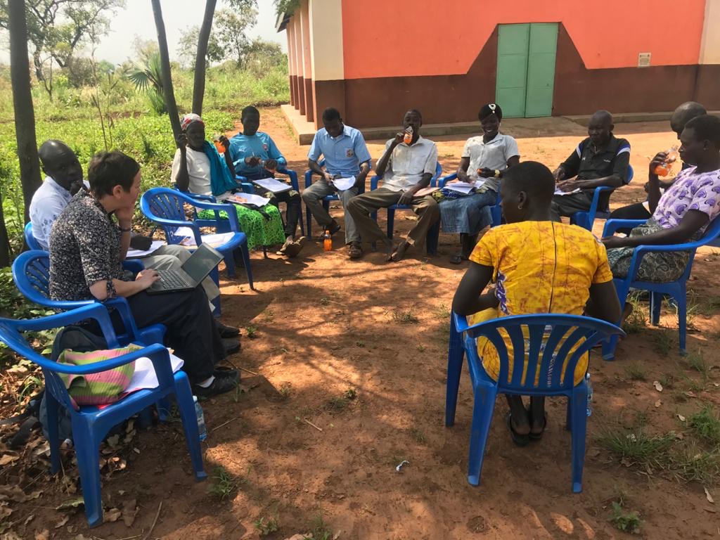
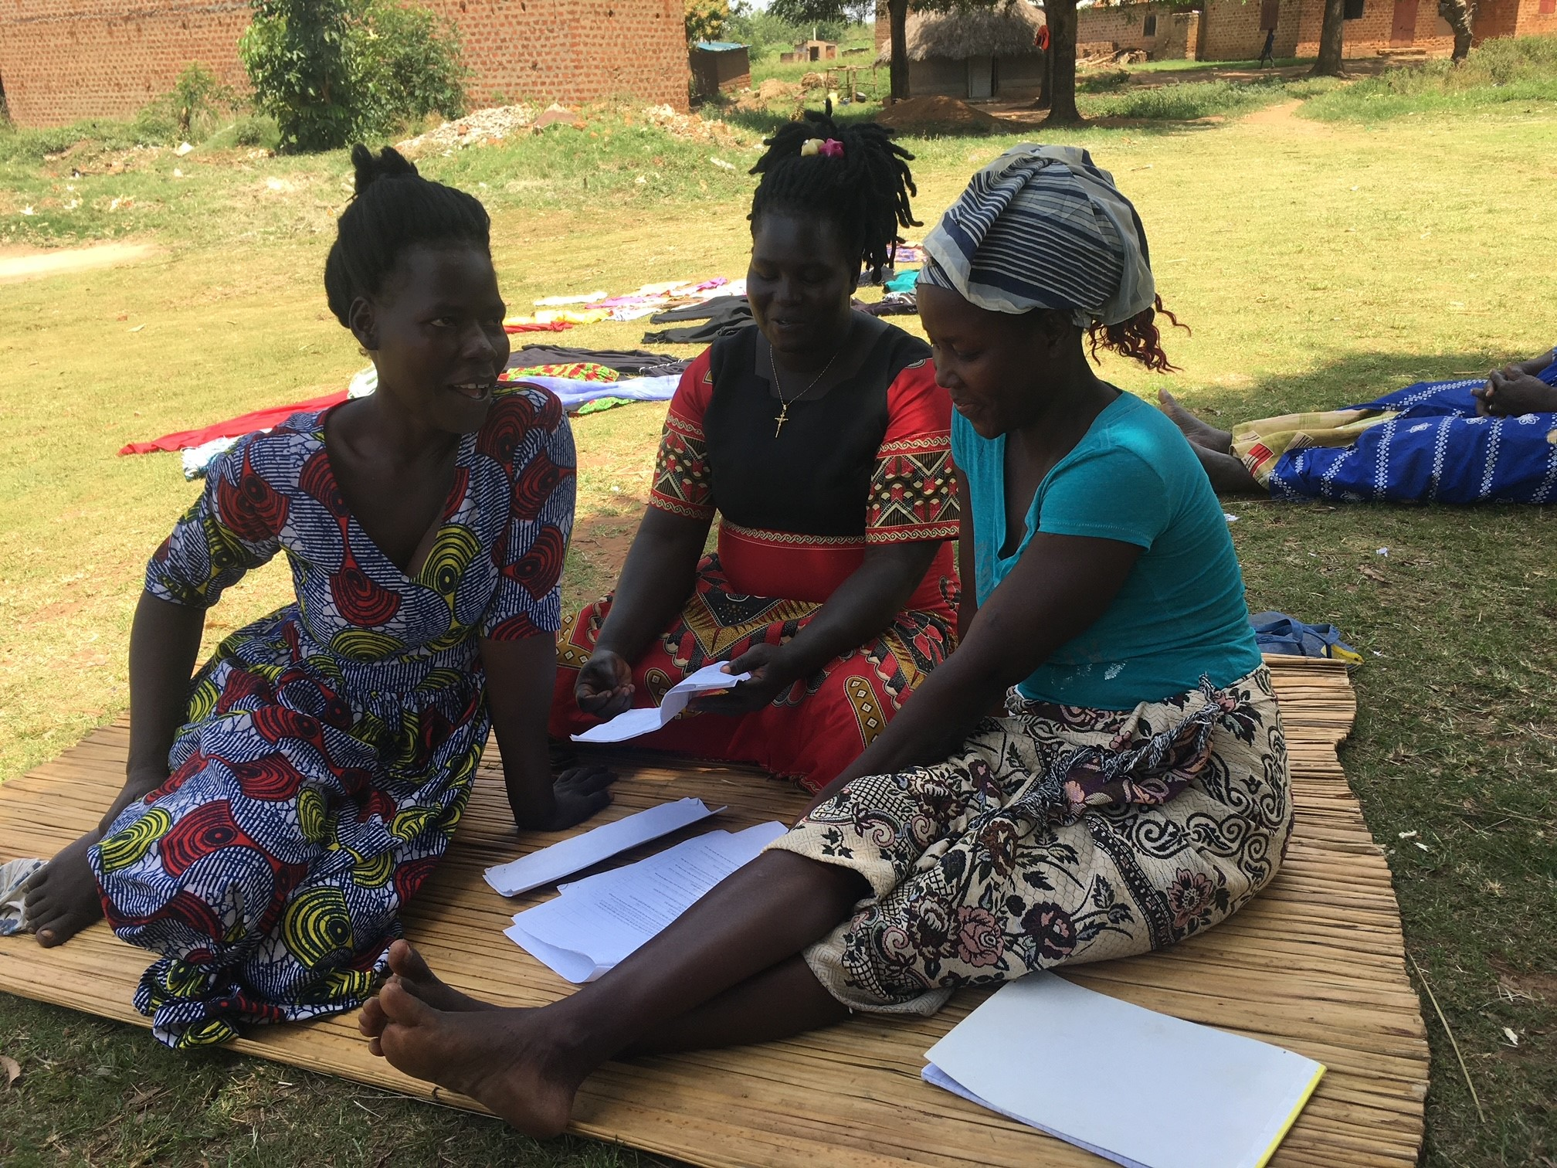
A participatory implementation study
Purposive selection of six villages from three districts in the greater Gulu region in northern Uganda
Purposive selection of participants from each study village
- different stakeholders in the pig value chain
- both men and women
Longitudinal study design with several interview components revolving around a co-created community contract on biosecurity
Photos: Erika Chenais
Notes:
for inclusion based on previous field confirmation of ASF, perceived interest in ASF control, availability of a suitable number (8-12) of smallholder pig farmers for the purpose of group discussions, and known presence of several different actors in the small-scale pig value chain in the respective villages

Slide 6
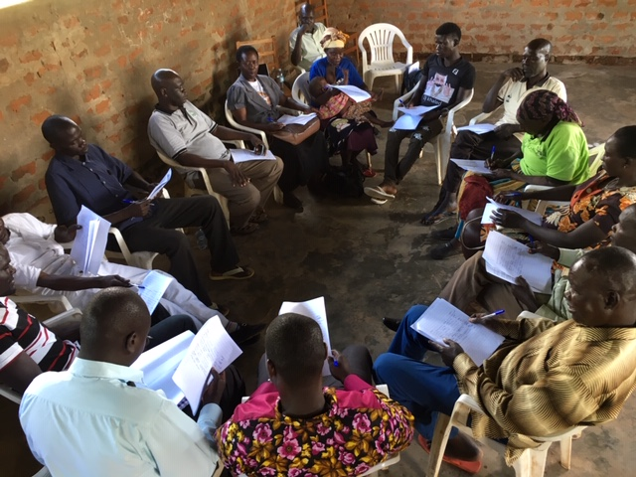
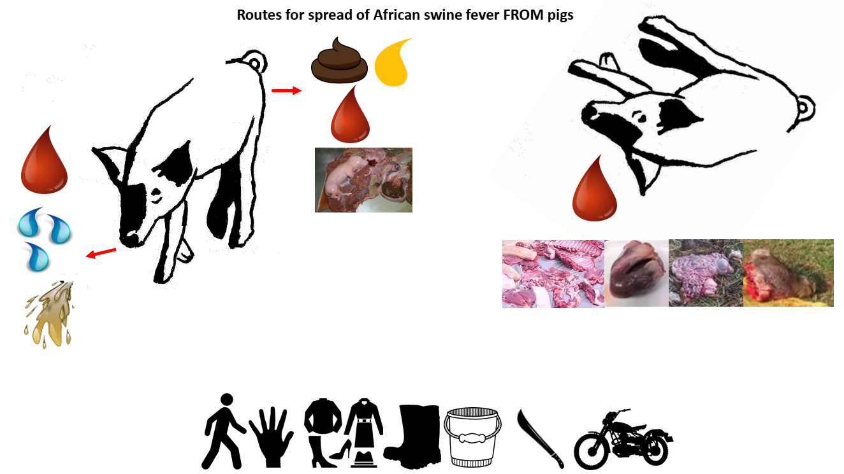
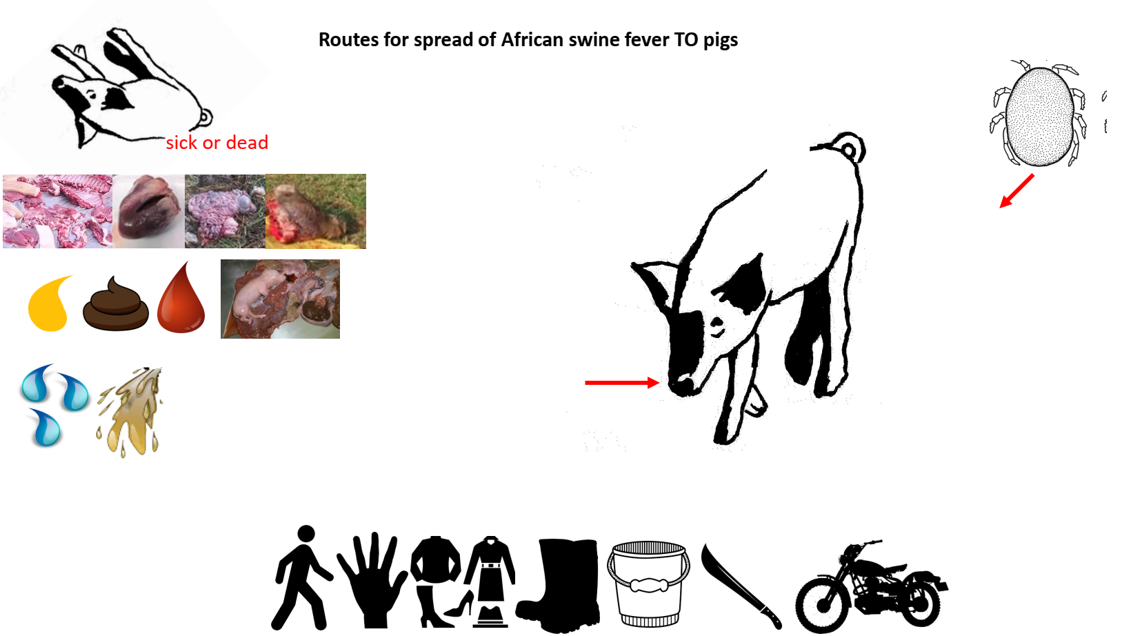
First meeting
FGD
ASF info
Separation in subgroups
Presentation of biosecurity measures suggested in community contract
Participatory decision on which measures to implement for one year
Co-creation of community contract
Notes:
Feasability, effectiveness

Slide 7
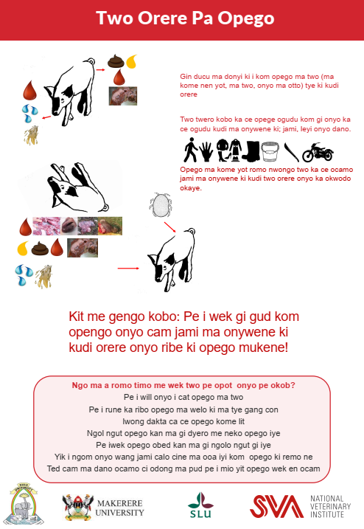
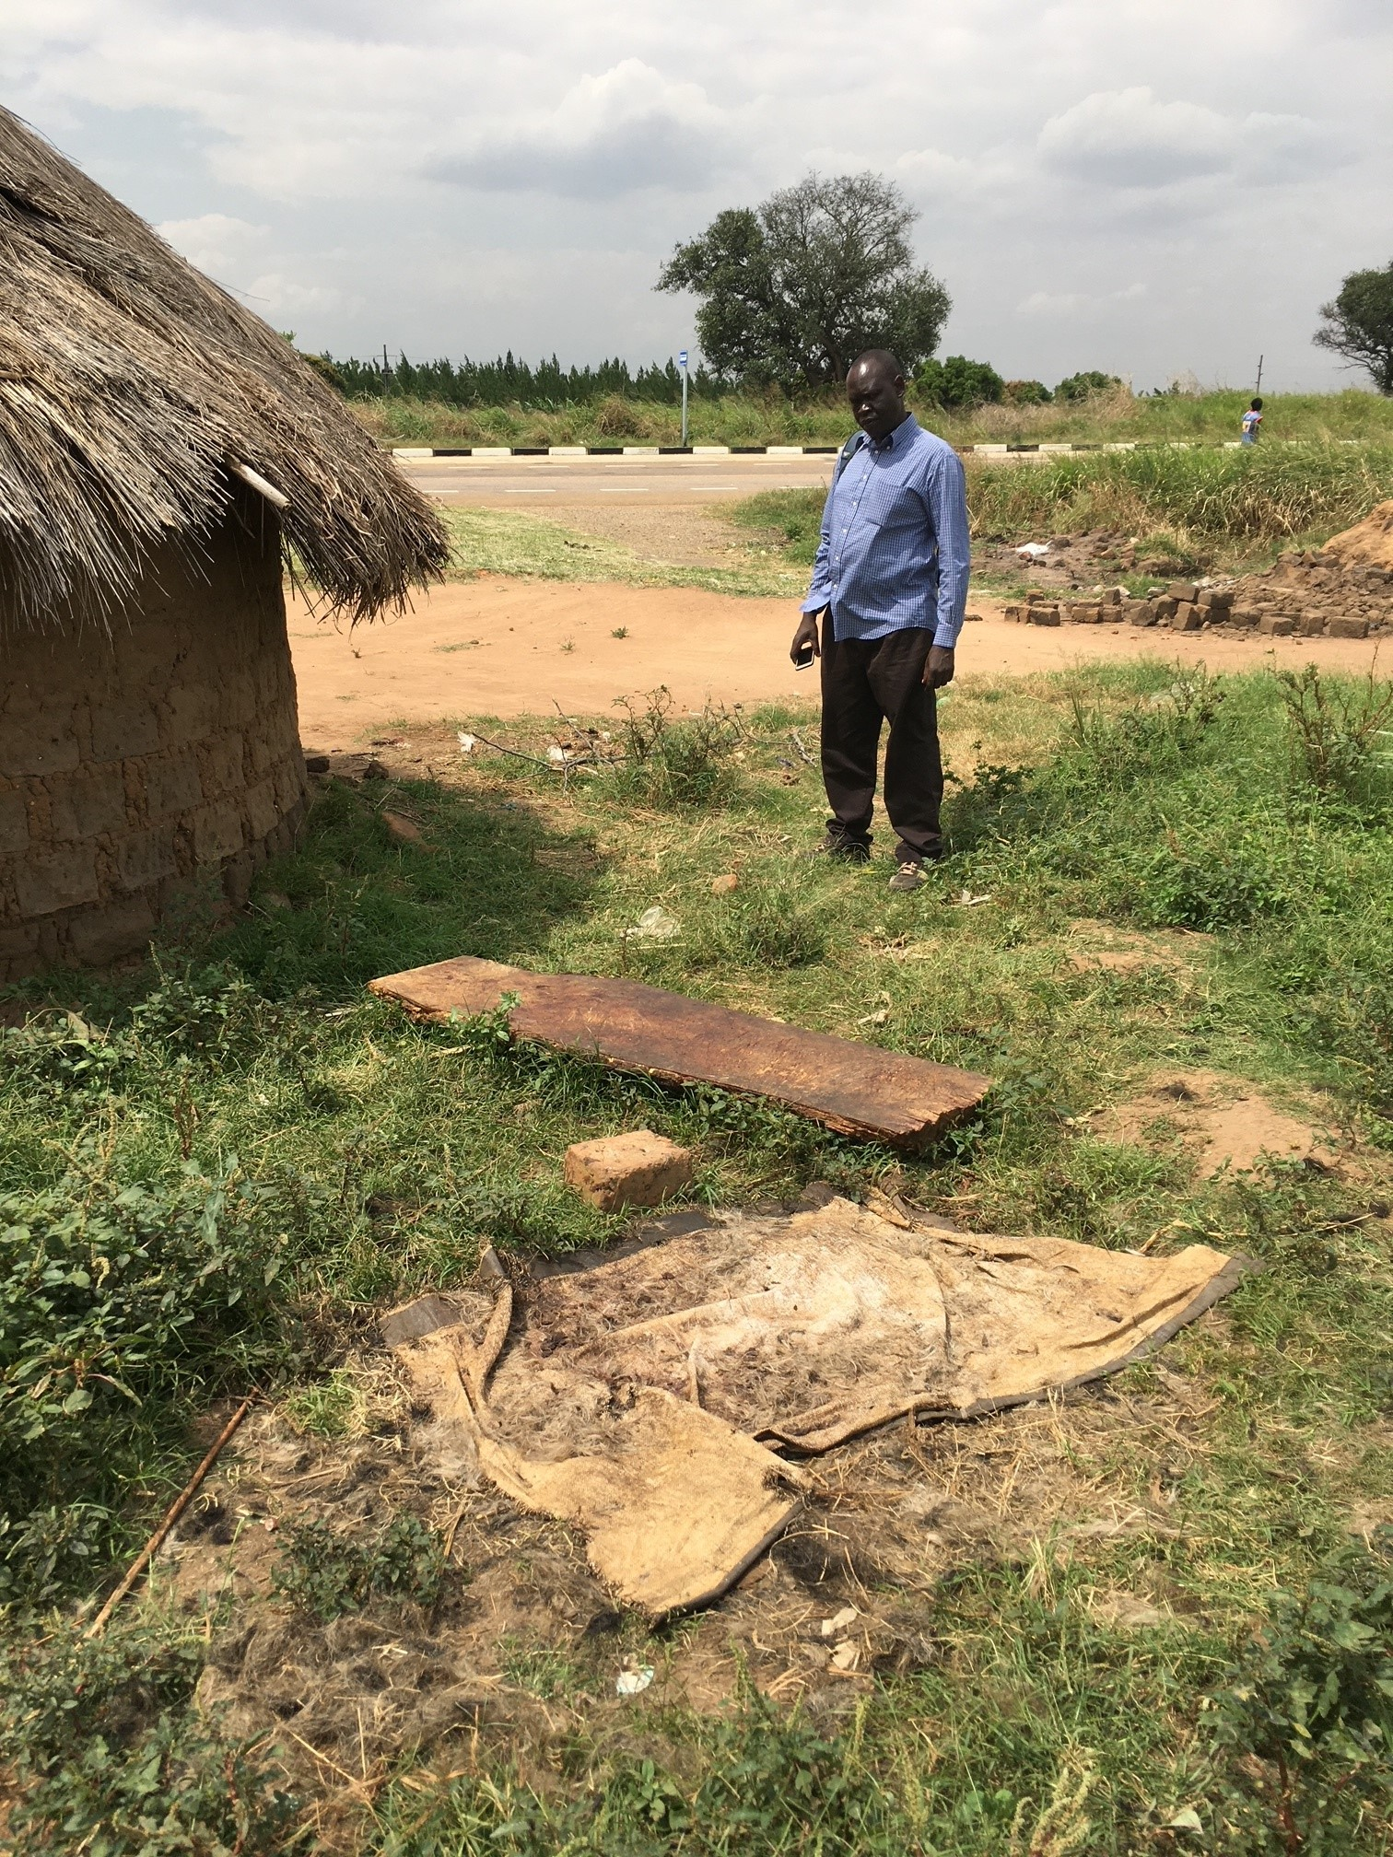
First follow up (+4 months)
Farmers: FGD
Traders: individual/duo/trio-interviews, field observations
Discussion
About the implementation of the measures in the contract
About the contract
About cooperation in the village
Support
Meeting with village officials
A poster
Individual biosecurity advice
Notes:
traders

Slide 8
Second follow up (+10 months)
Open meeting in each study village
Information about ASF
Distribution of poster
Semi-structured interview with original participants
About the implementation of the measures in the contract
About the contract
About cooperation in the village
About effects of COVID-19
Notes:
traders

Slide 9
First meeting
FGD
ASF info
Separation in subgroups
Presentation of biosecurity measures and participatory decision on measures to implement for one year
Co-creation of community contract
First follow-up
(+4 months)
Farmers: FGD
Traders: individual/duo/trio-interviews, field observations
Discussion
About the implementation of the measures in the contract
About the contract
About cooperation in the village
Second follow-up
(+10 months)
Open meeting in each study village
Information about ASF
Distribution of poster
Semi-structured interview with original participants
About the implementation of the measures in the contract
About the contract
About cooperation in the village
About effects of COVID-19
Notes:
Support
Meeting with village officials
A poster
Individual biosecurity advice

Slide 10
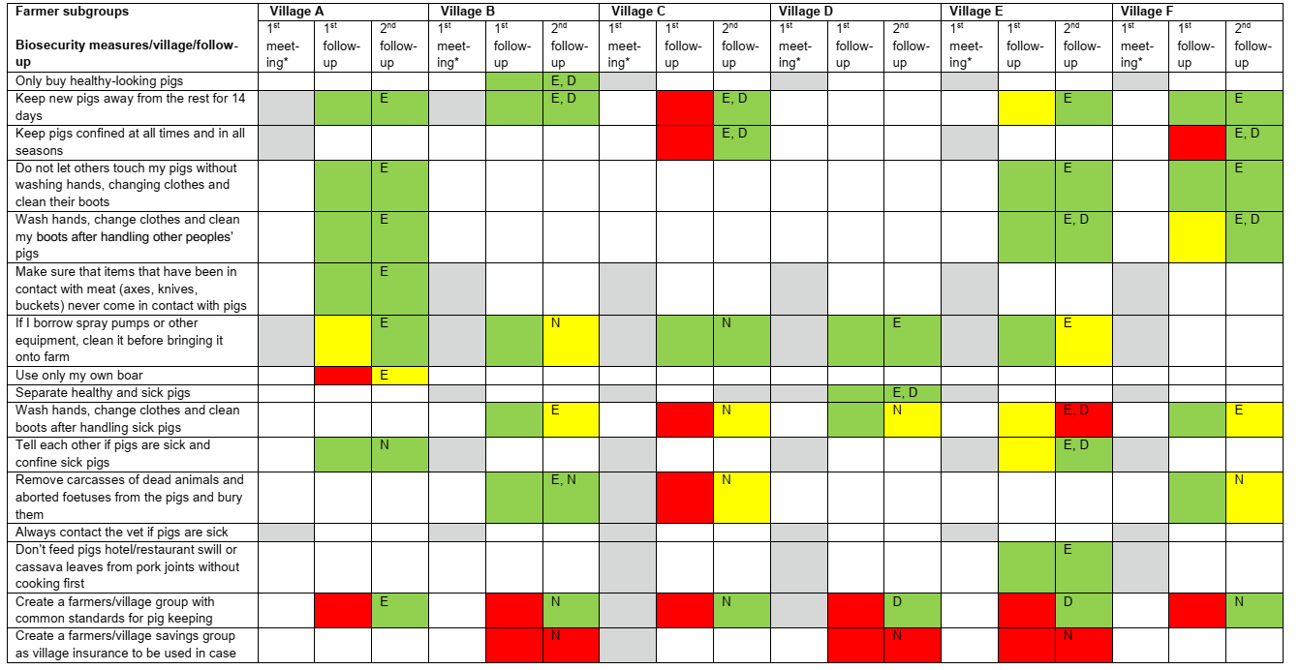

Slide 13
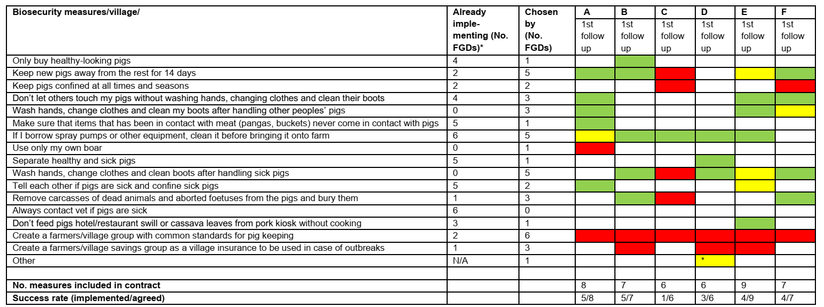
Notes:
Out of 16 measures proposed to the farmer subgroups in the first meeting, a minimum of six and maximum nine measures were chosen in each group (average 7.2). The measure “Create a farmers/village group with common standards for pig keeping” was chosen by all groups. The measure “Always contact vet if pigs are sick” was rejected by all groups. Several other measures were chosen by only one group. The other measures were each chosen by between two and five groups (average 2.6, mode 1). Out of 13 measures proposed to the traders’ subgroups, minimum three and maximum eight measures were chosen in each group. No measure was chosen by all these groups and two measures (“Make sure that items that has been in contact with meat, pig products or blood (pangas, buckets) never come in contact with pigs” and “Issue a health declaration of pork for sale“) were rejected by all groups. All other measures were chosen by between one and five groups (average 2.7, mode 4).

Slide 14
Groups that appear homogenous for the outside researcher make different biosecurity choices
->layers of diversity and heterogeneity
Diversity of selected measures
->complexity in smallholder farming

Slide 15
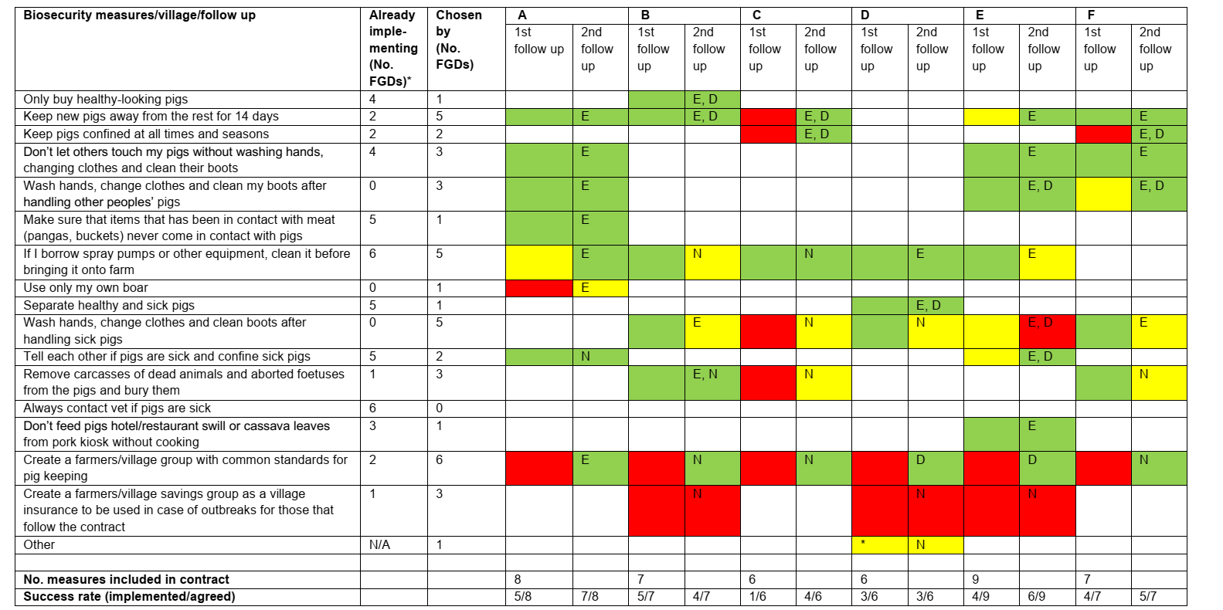

Slide 16
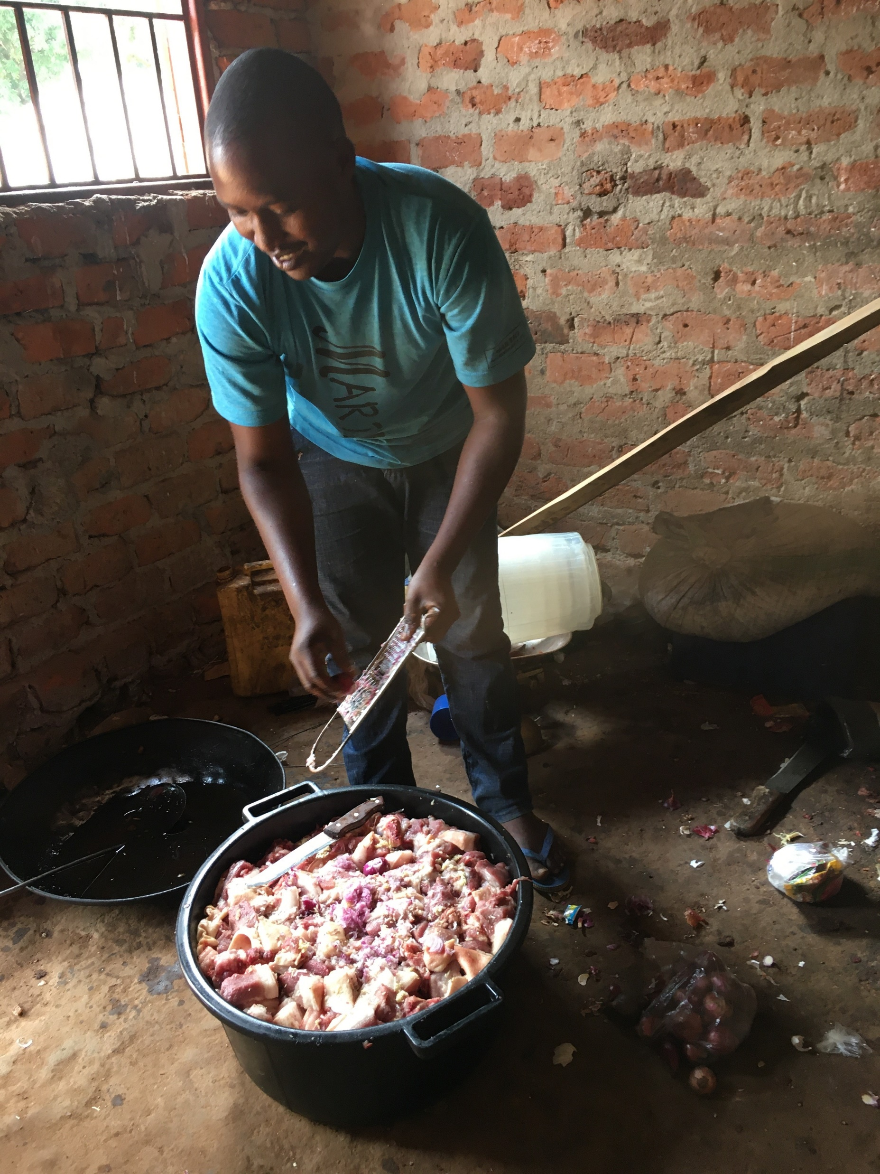
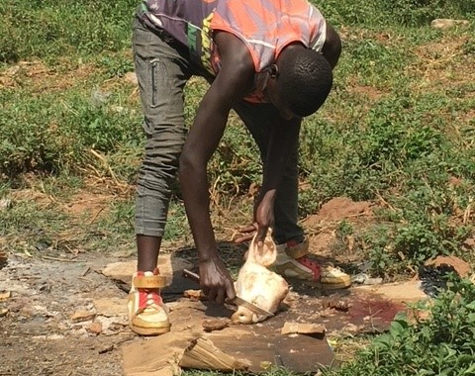
Reasons for rejecting measures
Already implemented
Not perceived as relevant for particpants’ pig keeping or disease reality
Not deemed feasible to implement by all group members
- village boars
Costs
- buying disinfectants, overalls, extra boots
- building a pig sty
Loss of income or food source
- discarding pork or dead/sick animals
Lack of infrastructure
- housing
- slaughter facilities
Cultural taboos and traditions
- bury animals
- wasting meat
-restricting access
Notes:
participants had known about the specific biosecurity recommendation before and the discussion had been a reminder for the implementation.
participants had acquired new knowledge during the discussion and that they therefore would change the implementation of the related biosecurity measures. For several measures it was mentioned that the implementation

Slide 17
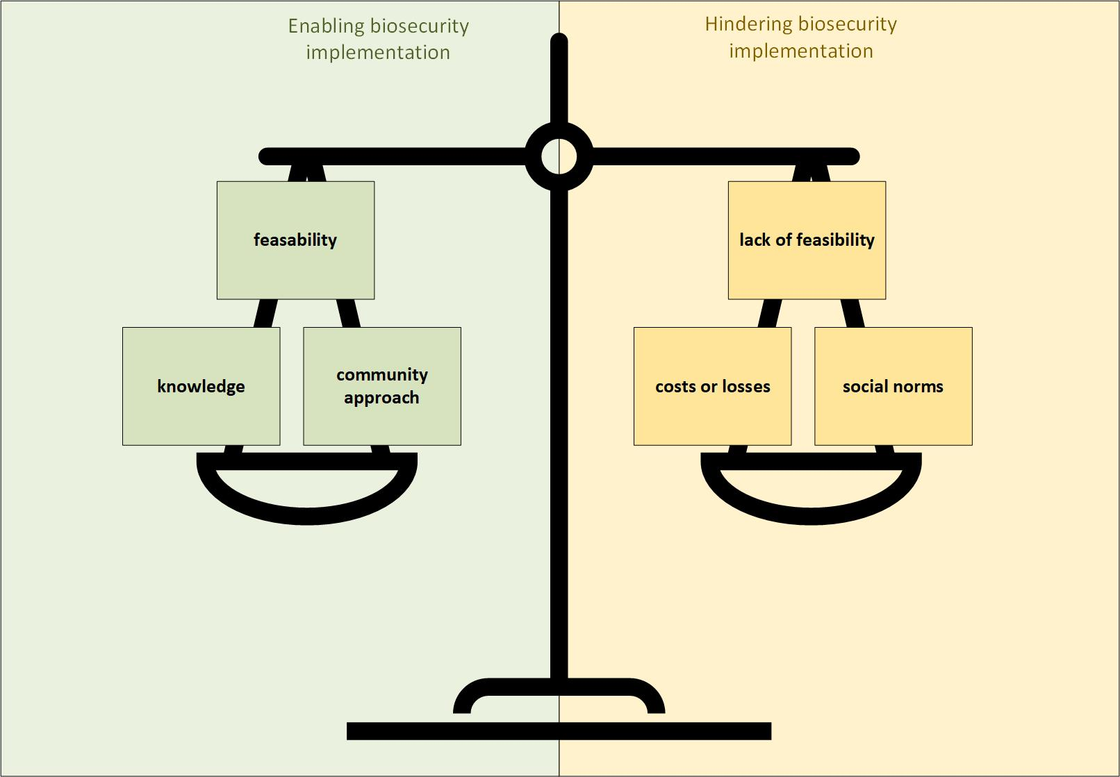
Notes:
Already implemented
Not perceived as relevant for particpants’ pig keeping or disease reality
Not deemed feasible to implement by all group members
- village boars
Costs
- buying disinfectants, overalls, extra boots
- building a pig sty
Loss of income or food source
- discarding pork or dead/sick animals
Lack of infrastructure
- housing
- slaughter facilities
Cultural taboos and traditions
- bury animals
- wasting meat
-restricting access

Slide 18
Some measures uniformly rejected – not enough understanding for the local context despite researchers’ long experience in the area?
Some basic biosecurity measures not previously known to prevent disease spread, but considered feasible and implemented with success
- confining pigs
- hand hygiene
- change of clothes and footwear
- separating healthy and sick pigs - not feeding swill
- having separate equipment at slaughter and at home
Notes:
Some actions chosen by all, some by none
None of the communities did everything, but all did something

Slide 19
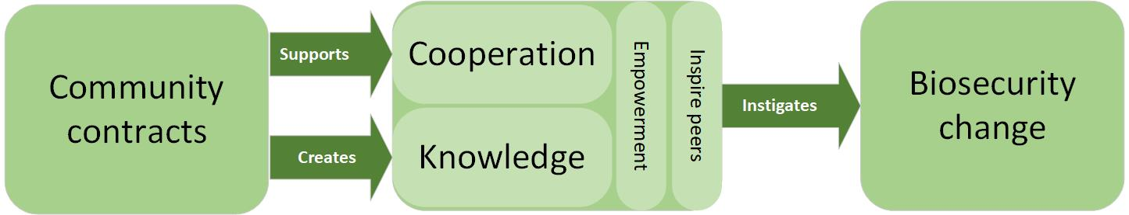
Participants described how they shared their knowledge and informed others about biosecurity
- positive attitude to the agreed measures and the strategy in the contract
Important to include the entire community, or let community members choose themselves if they want to participate
Co-created community contract instigated biosecurity changes
- participation, co-creation, local adaption, option to reject, community approach - contact goes beyond “the paper”
- create a “safe and neutral” venue for stakeholders to meet and talk to each other
- positive peer pressure
Notes:
Some actions chosen by all, some by none
None of the communities did everything, but all did something

Slide 20
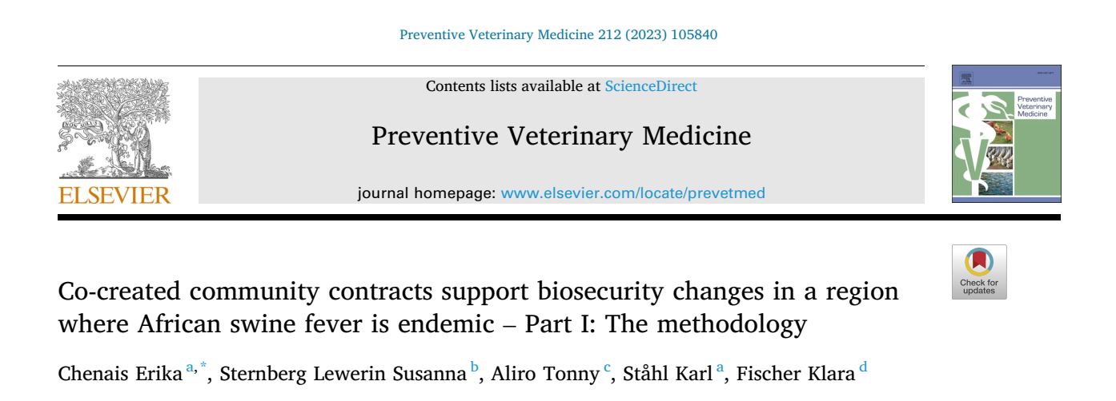


Slide 21
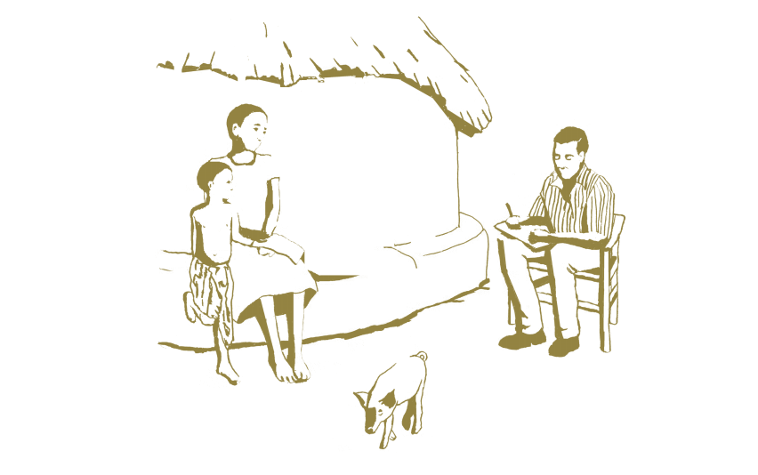




Acknowledgments
Study participants
Translators, facilitators and mobilisers
Co-authors
Funding agency

Slide 22

Thank you
erika.chenais@sva.se

